Slide 1
Light Emitting Diode (LED)

Slide 2
Some Applications of LEDs
Wavelengths and Applications of LEDs
LED Wavelength (Colour) | LED Applications
410-420 nm (Violet) | Skin therapy
430-470 nm (Blue) | Dental curing instruments
470 nm (Blue) | White LEDs using phosphor, blue for RGB white lights
520-530 nm (Green) | Green traffic signal lights, green for RGB white lights
580-590 nm (Amber) | Amber traffic signal lights, amber for RGBA white lights
630-640 nm (Red) | Red traffic signal lights, red for RGB white lights
660 nm (Deep Red) | Blood oximetry
680 nm (Deep Red) | Skin therapy
800 – 850 nm (Near IR) | Night-vision illuminators and beacons for use with night-vision goggles or CCDs
850-940 nm (Near-IR) | Photoelectric controls
940 nm (Near-IR) | Covert illumination CCD-based systems

Slide 3
Working Principle of LED
λ is wavelength
h: Planck’s constant (6.626 × 10⁻³⁴ Js)
c: velocity of light (3x 10⁸ m/s)
E_{g} : Energy band gap of a direct band gap semiconductor
E_{C}
-
-
-
-
-
-
-
-
Colour | λ (nm) | E_{g} (eV)
Red | 650 | 1.91
Green | 530 | 2.34
Blue | 480 | 2.59
Violet | 430 | 2.89
E_{g}
λ
E_{V}
+
+
+
+
+
+
+
+
+

Slide 4
Direct Band Gap Semiconductors

Slide 5
Direct and Indirect Band Gap Semiconductors

Slide 6
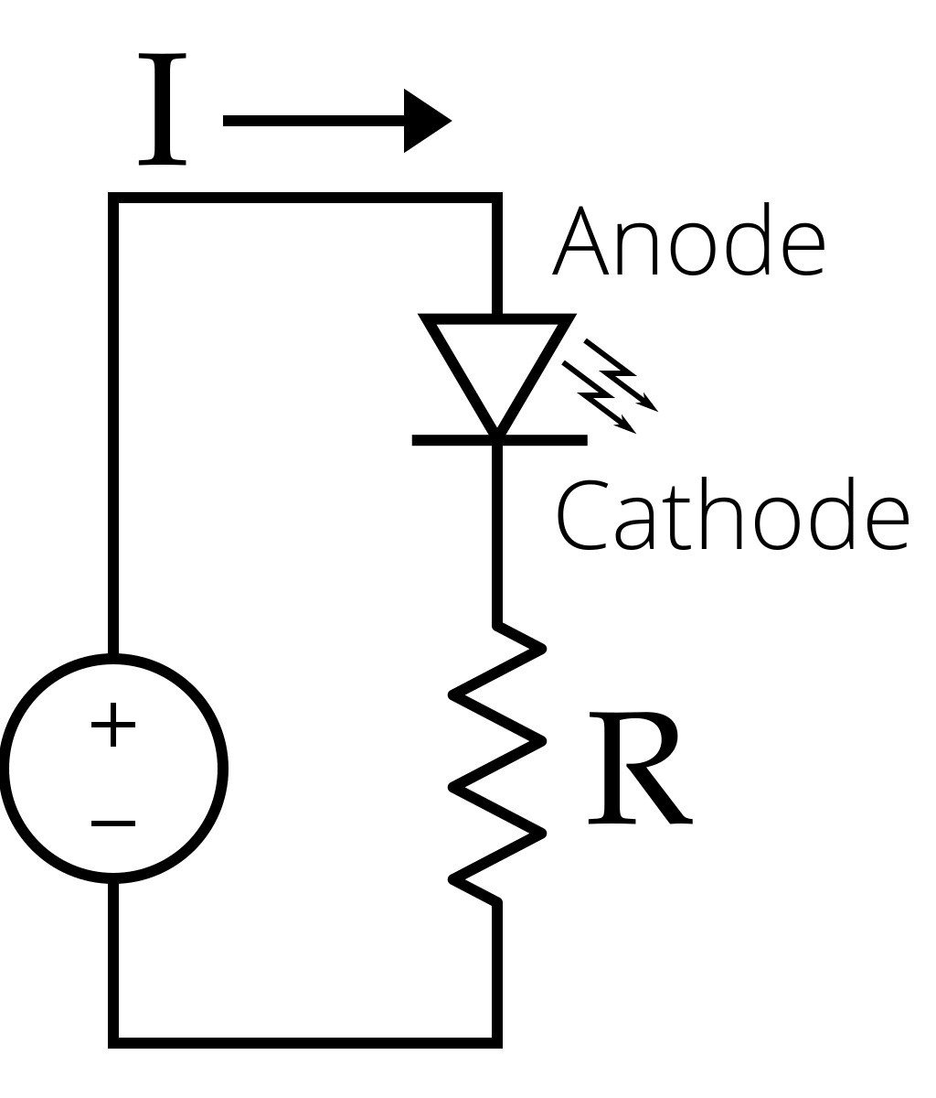
Voltage Across LED and Resistor
What is voltage across the diode?
Forward voltage of an LED is between 1.8 V and 3.3 V
Varies by the color of the LED
A red LED typically drops 1.8 V
Voltage drop and light frequency increase with band gap
A blue LED may drop from 3 V to 3.3 V
Hint: look at electro-optical characteristics
What is the voltage across the resistor?
Apply KVL
+
2 V
-
+
7 V
-
9V

Slide 7
Connecting LED
LEDs will only illuminate with correct electrical polarity
The voltage across should forward bias the p-n junction.
In the forward bias, a significant current flows and the LED glows
In the reverse bias, very little current flows, and no light is emitted
When connected to an AC supply, will glow in the half cycle where the LED is forward biased
LEDs have low reverse breakdown voltage ratings and will be damaged by an applied reverse voltage above this threshold.
The cause of damage is overcurrent resulting from the diode breakdown, not the bias voltage.
When the current through the LED exceeds (above the current rating), LEDs also breakdown in forward bias.

Slide 8
Current Rating
The maximum current rating is about 25 mA
absolute maximum ratings
All the LEDS in the lab have a 25 mA rating
Let I = 21 mA.
Smaller the resistance is, larger the current is and brighter is the LED glow.
+
2 V
-
+
7 V
-
9V

